Slide 1
Government Regulations & Competition
Chapter 4 Section 4

Slide 2
Reasons for Regulation
We learned previously how Monopolies and Oligopolies have Market Power.
  Market Power- The ability to control prices and total output.
To control prices and output, sometimes firms in a market participate in Predatory Pricing.
  Predatory Pricing- Selling a product below cost for a short period of time to drive competitors out of the market.

Slide 3


Business Regulations
To keep firms from controlling price and supply, the government enacts various regulations:
Antitrust Laws
Regulation of Business Practices
Splitting up Monopolies
Blocking Mergers
The Sherman Antitrust Act of 1890 gave the government the power to regulate industry, stop the formation of cartels/monopolies, and break up existing monopolies.

Slide 4
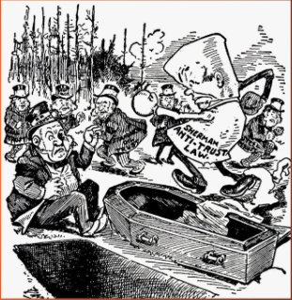
Antitrust Laws
A Trust is a business combination similar to a cartel.
The goal of Antitrust Laws is to keep firms from coordinating prices and production in order to get more money out of consumers.

Slide 5
Monitoring of Business Practices
If a company becomes too powerful, the government has the power to regulate its practices that reduce competition.
Example: United States vs. Microsoft

Slide 6
Breaking up of Monopolies
Monopolies dominate a market, thus there is no competition.
The government has the power to prevent monopolies from entering the market, and the power to break up monopolies that are created.

Slide 7
Blocking Mergers
A merger is when two or more companies join to form a single firm.
When the number of firms in a market decreases, the price of their good typically increases.
Although each merger is viewed separately, the government usually goes by the guidelines that “mergers should not be permitted to create or enhance market power”.

Slide 8
Deregulation
As time has passed, the government has decided that some forms of regulation have actually inhibited competition.
As a result, the 1970’s and 1980’s saw a new push for Deregulation to stimulate competition.
Deregulation- The government no longer decides what role a company plays in a market and how much they can charge their customers.

Slide 9
Types of Deregulation
In order to enact deregulation, the government usually takes 3 measures:
  Cut regulations that reduce competition
  Eliminate price controls- removal of price ceilings and price floors to allow prices to reach a natural equilibrium.
  Remove barriers to entry- make it easier for firms to enter and exit the market freely.

Slide 10

Economic Goals
The ultimate goal of the government is to make market practices in the economy fair and competitive.
The government must find a unique balance between regulation and economic freedom in order to ensure a healthy level of competition in the economy.

